Slide 1

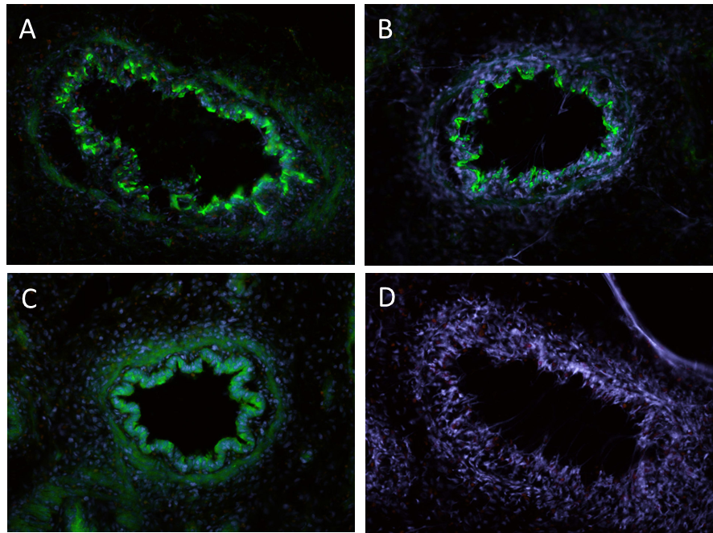
ReliaTech GmbH
Rabbit anti-rat PlGF
(Cat #104-PA04S; #104-PA04 )
Figure: Rat embryonic lung tissue labeled with polyclonal antibody against rat PlGF (green) [Cat# 104-PA04]: (A) and (B) unfixed; (C) after sectioning fixed with PFA; (D) unfixed negative control. Note the specific signal in bronchial epithelial cells. Nuclei are counterstained with Dapi (blue).
The experiment was performed by the research group of Prof. Dr. J. Wilting and Dr. K. Buttler, University Medicine Göttingen, Germany.
http://www.reliatech.de / orders@reliatech.de

